Slide 1

Water Detection Algorithm Overview
Prepared by: Intelligent Product Solutions, R. Lieb
Applies to: Gen 2 Afridev UNiTS
April 3, 2019

Slide 2
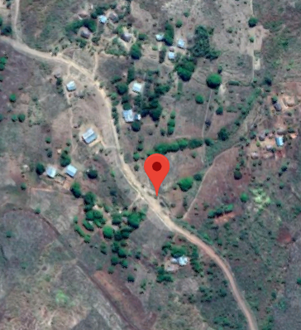
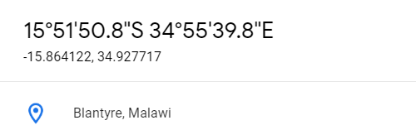
Malawi Installation

Slide 3
Use of Capacitive SENSING and Water Detection
The probe of the Afridev unit has 6 pads that are monitored in parallel.
The presence of Air or Water is independently monitored every 2 seconds.
Capacitance measurements are made every half-second.
The firmware uses a standard TI library: TI_CTS_RO_PINOSC_TA1_TB0_HAL
Capacitance levels are expressed in ”counts”.
The original Afridev design had a hardware defect that caused shortened counts
The final board layout does not appear to have this problem.
The firmware has code to detect these measurement errors as ”Outliers”
An outlier has a value outside the range of 1500 counts from the last mean

Slide 4
TRENDING DATA
“mean” – The average of the last 2 seconds of data (up to 4 samples)
“last mean” – The mean measured in the previous 2 second period
“air target” – The current estimate of where “100% air coverage” is detected. It is the most recent maximum mean value (given the current temperature)
“water target” – The current estimate of where “100% water coverage” is detected. It is the most recent minimum mean value (given the current temperature)
“midpoint” – The half-way point between the “air target” and the “water target” measurement. When the “mean” falls below this point, then it is going “towards water”, above this point “towards air”.
“proportional coverage” – The estimate of how much the highest pad is covered with water. Pads below this point are covered 100% with water. This is used in the Flow Rate calculation.
“air deviation” – The difference between the air target and the current mean. Used for flow calculations

Slide 5
Water Detection using Capacitance
The probe design detects water by observing clear jumps in measured capacitance data
The jump magnitude varies by factors such as board thickness, foam density behind the board
Nominal jumps between air and water have been observed between 450 and 1050 counts
Air
Water

Slide 6
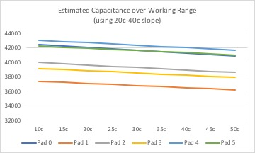
Water Detection using Capacitance
The capacitance level measured varies by ambient air temperature over the pad
The level decreases from 3 to 4 counts per tenth of degree Celsius
Each pad has its own linear degradation slope: (counts/0.1 degree C; from 10c to 50c)
The values also vary from one pad to another based on hardware differences.
P0: -4.01 | P1: -3.02 | P2: -3.45 | P3: -3.12 | P4 : -3.45 | P5: -2.99

Slide 7
Measurement Goals
The algorithm determines the state of all six pads every 2 seconds
Pad State | Indicator | Description
Unknown State | ‘?’ | Air and Water Targets are not yet established
Air Maximum | ‘A’ | The mean is at the Maximum value
Air Midpoint | ‘a’ | The mean is at or above the midpoint but below the maximum seen so far
Water Midpoint | ‘w’ | The mean is below the midpoint, but above the minimum seen so far
Water Minimum | ‘W’ | The mean is at the Minimum value
The algorithm estimates the percentage of the pad that is covered with water

Slide 8
A pumping session on the well… Looking at “air deviation”
T2c84 t=22.1C 0(w)0505 1(?)0390 2(w)0410 3(?)0384 4(w)0389 5(?)0164 L1F000uP000u
T2c86 t=22.1C 0(W)0954 1(W)0745 2(W)0834 3(W)0750 4(W)0857 5(W)0477 L6F900 P100
T2c88 t=22.1C 0(W)0954 1(w)0742 2(w)0830 3(W)0751 4(w)0852 5(W)0491 L6F900 P100
T2c8a t=22.1C 0(w)0952 1(w)0738 2(w)0828 3(W)0758 4(W)0867 5(W)0503 L6F898 P099
T2c8c t=22.1C 0(W)0975 1(W)0757 2(W)0845 3(W)0769 4(W)0877 5(W)0511 L6F900 P100
T2c8e t=22.1C 0(w)0973 1(W)0767 2(w)0839 3(W)0778 4(w)0693 5(a)0117 L5F750 P100
T2c90 t=22.1C 0(w)0942 1(w)0541 2(A)0000 3(A)0000 4(A)0000 5(a)0065 L2F150 P000
T2c92 p=04498ml
T2c92 t=22.1C 0(w)0517 1(A)0000 2(A)0000 3(A)0000 4(A)0000 5(a)0066 L1F000 P000
Time Pad Temp Air Deviation Water Level Flow Rate Proportional Coverage Unknown State Pad State

Slide 9
Measurement Activities
The algorithm uses the following activities to determine the pad’s state and proportional coverage:
Heat Analysis
Jump Analysis
Midpoint Analysis
Water Level Detection
Flow Rate Calculation

Slide 10
Heat Analysis
Before any other analysis can be done, the targets need to be adjusted based on changes in air temperatures over the pads
The system reads the pad temperature every 10 seconds
The Air and Water Target values are adjusted up or down based on the temperature difference from the previous measurement.
Without making these adjustments, water may be erroneously detected when the temperature changes up 10 degrees C or more.
The adjustments continue whether or not water is being pumped

Slide 11
JUMP Analysis
The current mean is compared against the last mean measured.
The current pad temperature is recorded when a target is changed
Observed changes | Event | Result
mean jumps down 225 counts or more than the last mean | “big jump” | Sets new water target up or down
mean jumps up 225 counts or more than the last mean | “big jump” | Sets new air target up or down
Mean jumps below water target | “small change” | Sets water target down only
Mean jumps above air target | “small change” | Sets air target up only

Slide 12
Midpoint Analysis
The capacitance level makes a jump from air to water, and water to air
The presence of water affects the measured capacitance level below the physical location of the pad
The midpoint is a rough estimate of when the water has reached the bottom of the pad’s physical location
The location of the current mean in relation to the midpoint dictates the detected state of the pad

Slide 13
Water Level Detection
The water level determination is done by finding the highest pad that has some coverage of water.
On the well configuration, the lowest pad is numbered 5 and the highest pad 0
In testing, when the unit is plunged over water, the lowest pad is 0 and the highest pad 5
When an “unknown” state is detected, any pad with a detection of water above the detection of air is ignored.

Slide 14
Flow Rate Calculation
The water flow is calculated by dividing the pipe output in 6 zones. One zone per pad
Water flows out by gravity and the calculation is made by estimating the area of the output pipe filled with water.
The percentage of the pipe filled with water is multiplied to the maximum flow of 469ml/sec to calculate the output of water per second
In the example, the pad 2 percentage is calculated using the Proportional Coverage metric
 | Total Flow 469ml/sec
Pad 0 | 9.3% | 0% | 0%
Pad 1 | 16.8% | 0% | 0%
Pad 2 | 18.6% | 30% | 5.6%
Pad 3 | 19.9% | 100% | 19.9%
Pad 4 | 19.3% | 100% | 19.3%
Pad 5 | 16.1% | 100% | 16.1%
 |  |  | 60.9%
 |  | 285.6 ml/sec

Slide 15
Proportional Coverage
The “air deviation” is used to measure the percentage of the pad that is covered with water
The first 450 counts (roughly the midpoint) is counted as air
The proportion of the current mean between the midpoint and the water target is used to calculate the percentage of the pad that is covered with water
Proportional Coverage →
← Air →
450 counts
100% ← Water → 0%
← Air Deviation →
Water
Target
Current
Mean
Midpoint
Air
Target

Slide 16
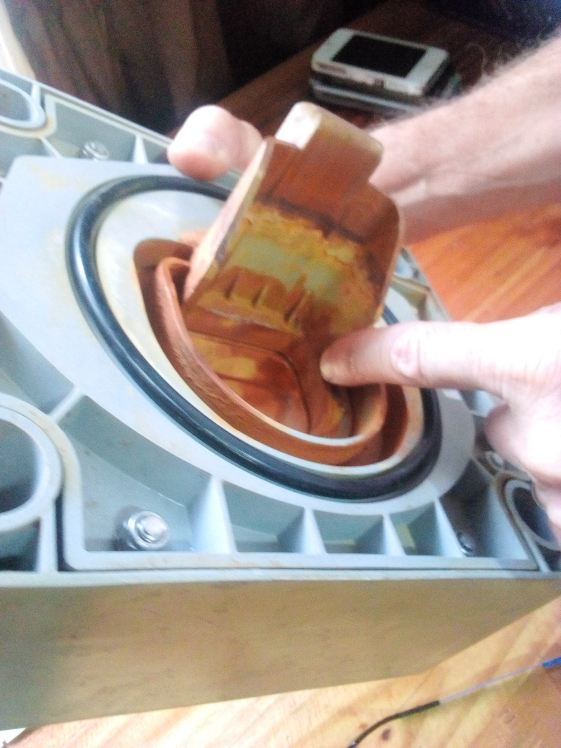
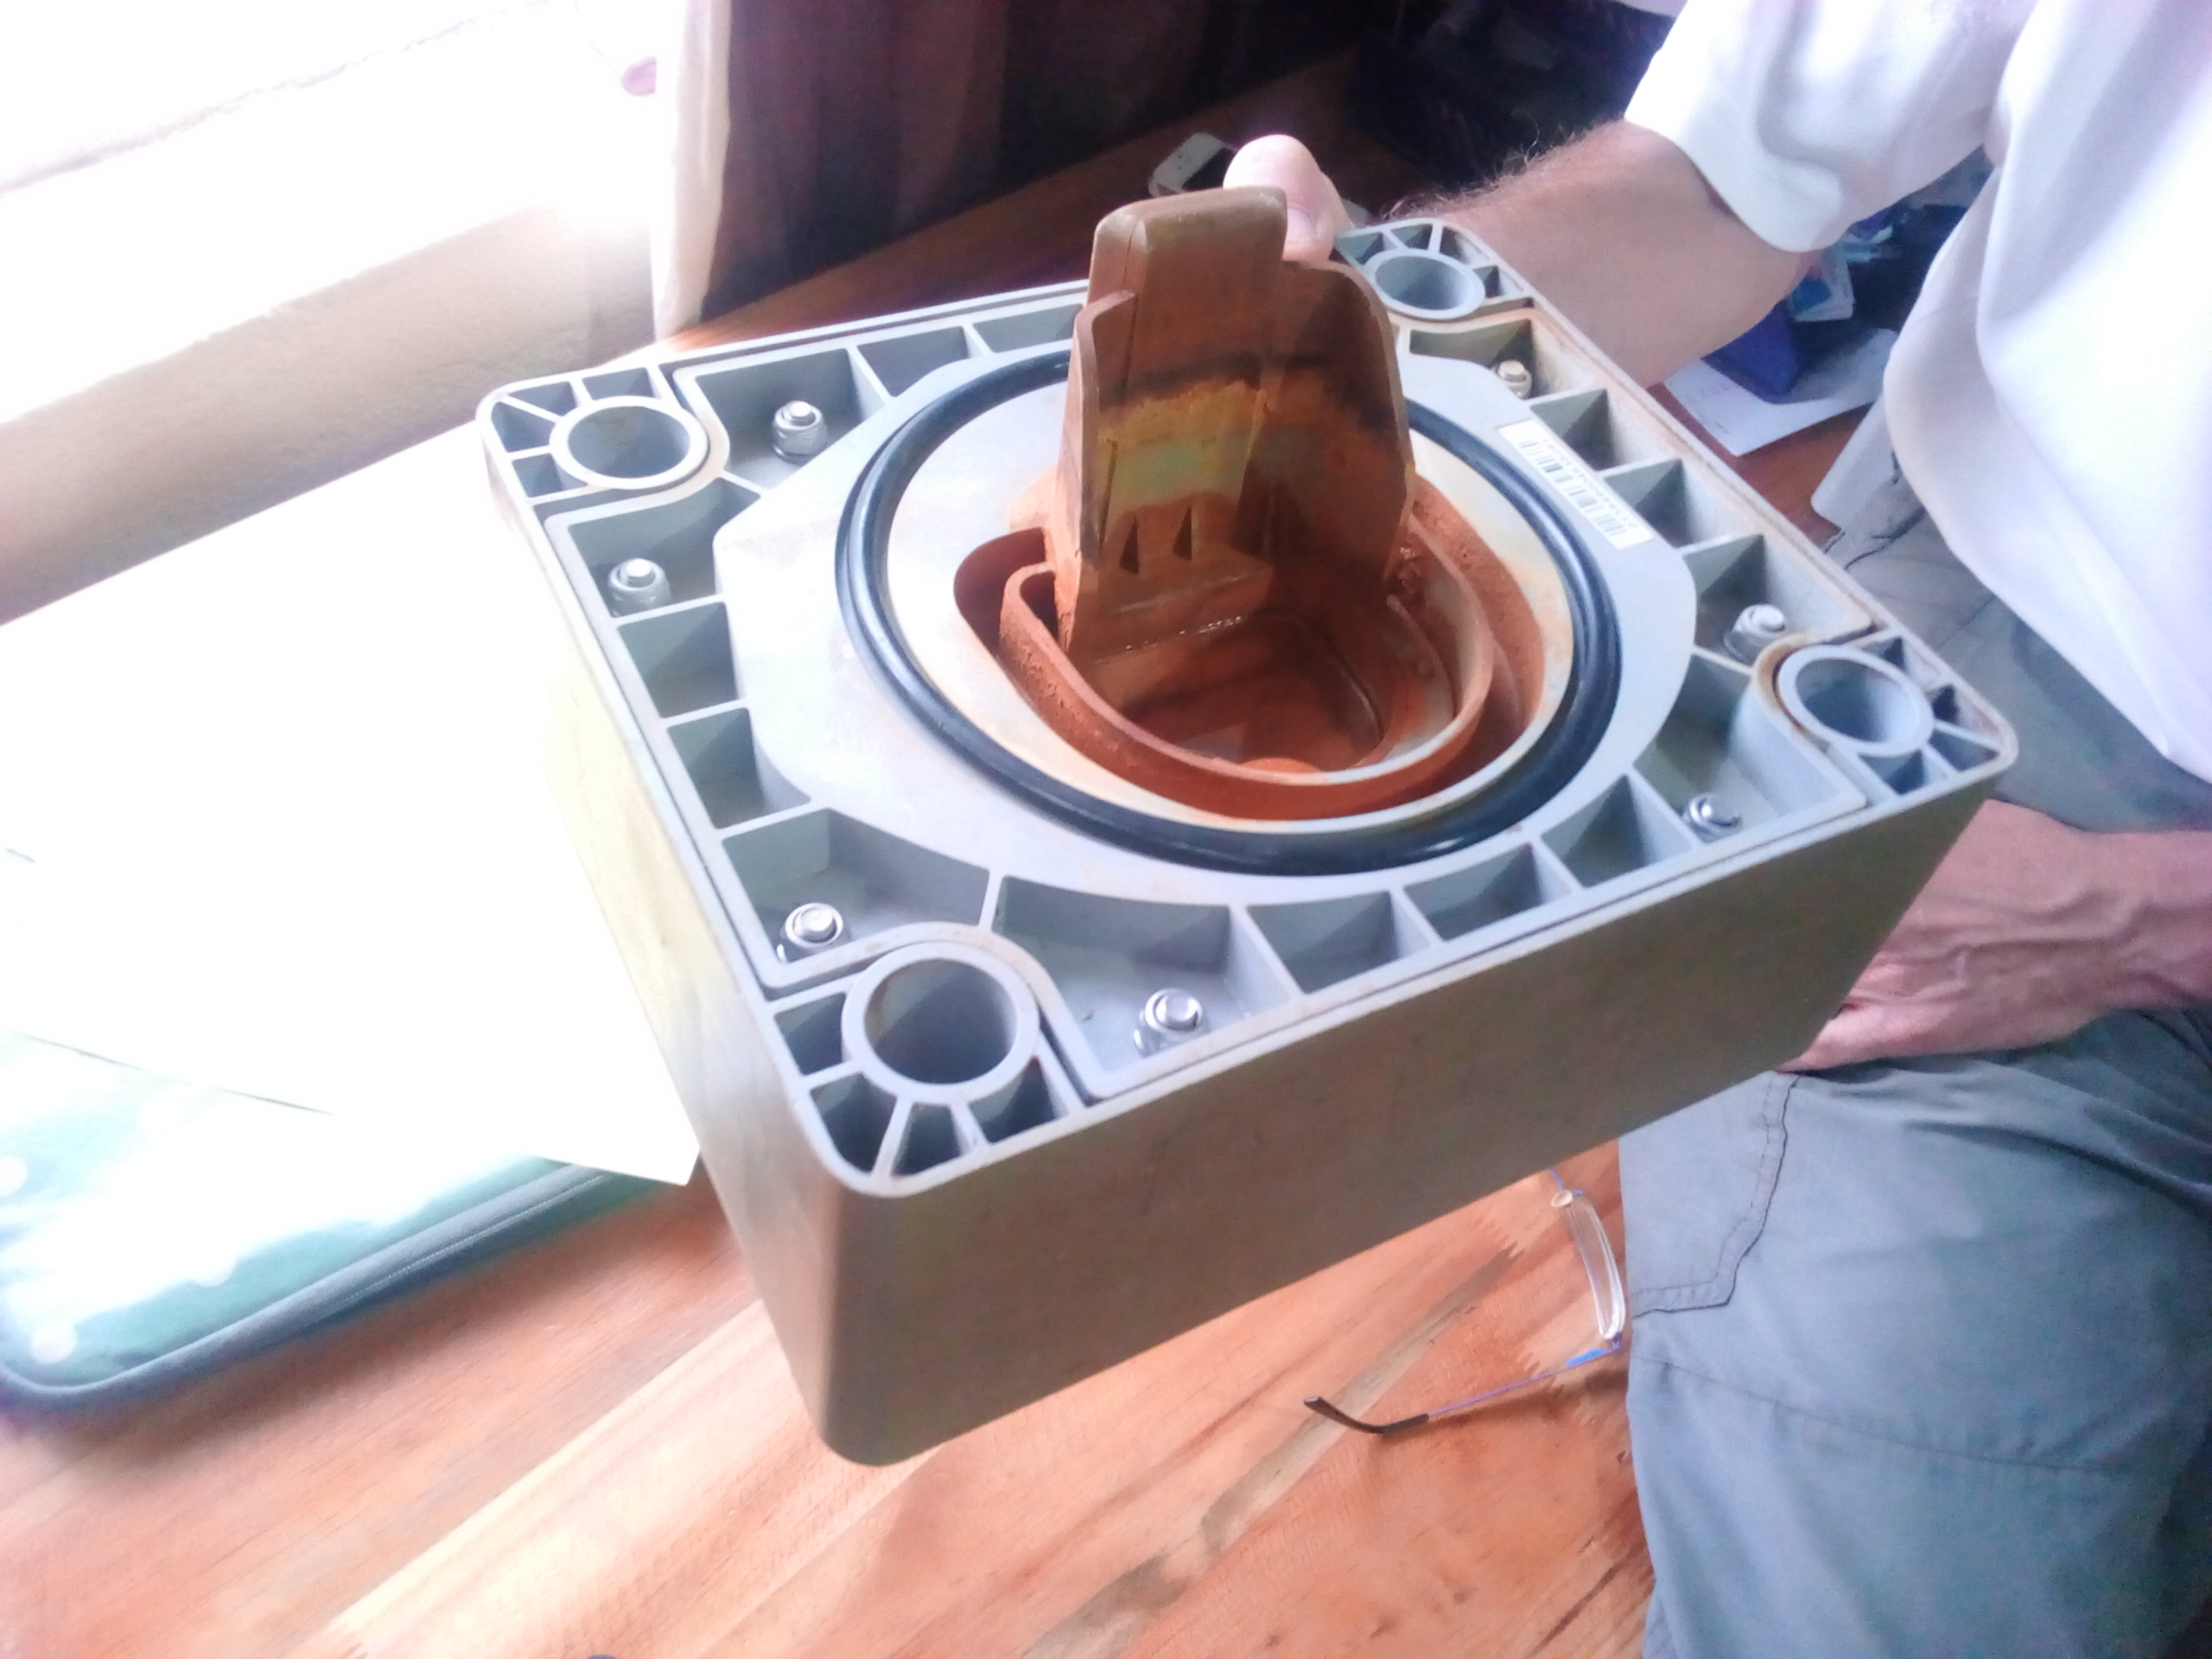
Sedimentation
The variable level of sediments is something that this design cannot predict or detect. It is an inherent limitation of using capacitance to measure water.
If a pump had a 300 foot pipe to the bottom of the well, when pumping stops for the day, the sediments have a chance to settle to the bottom.
When pumping starts again, the water will be relatively sediment free until the pipe length of water is drawn up.

Slide 17
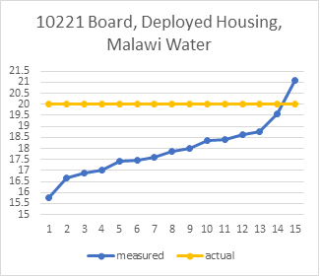
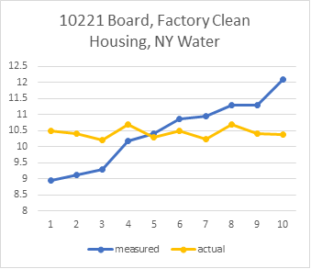
Sediments in water SKEWS WATER ESTIMATES
The water detection algorithm depends on a linear distribution of data between the air and water targets to detect the presence of water.
Sediment laden water has higher capacitance values (which leans towards the “air” side)

Slide 18
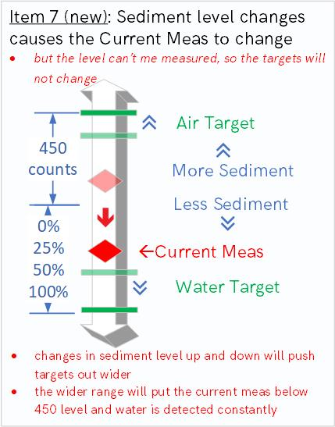
Sediment Values are not Constant
The highest and lowest levels of sediments will cause the capacitance count levels to increase, not jump
As the “Margin” between Air and Water widens, the Target range for water grows
Pads will start reporting Water when there is Air. They become “Water Stuck”

Slide 19
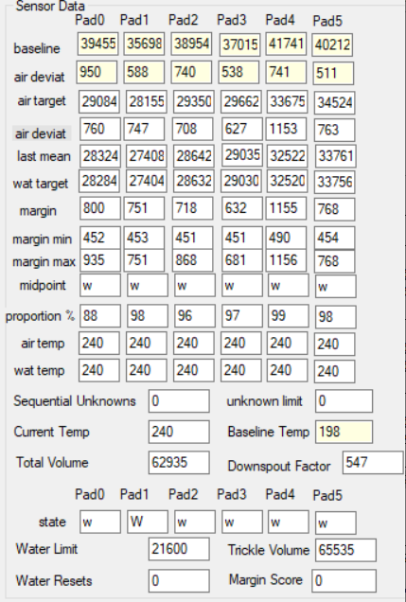
Detection of Water Stuck Condition
The product requirements for the Afridev2 had no stipulations for the quality of the water, and the current design has no way of detecting the sediment level in the water to adjust the measurements.
Is it possible to detect when the water quality has reached a level where the algorithm loses the ability to detect air vs. water?

